Slide 1



SUPERSTORE SALES
Data analysis Using Python
Nancy Ahmed Mohamed
Fatma Mohamed El Sayed
Nehal Nabil Ibrahim
Norhan Mohamed Mohamed
Nardine Emad Salama

Slide 2



LIST OF CONTENTS
Data Description
Data Cleanning
About the Company
Data Visualization
Conclusion

Slide 3



ABOUT THE COMPANY
Superstore is a fictional retail company based in the United States.
They specialize in selling furniture, office supplies, and technology products.

Slide 4

It contains about 9993 sales transactions that occurred from 2015 to 2018.
Encompasses a wide range of information, including order specifics, geographical data, and product-related data.
(9800 row, 18 column)
Data types: float64(2), int64(1), object(15)
Data Description

Slide 5

Data Cleaning!
Only postal code has 11 missing values
Replace null values with postal code of Burlington
Change order and ship date data type into date type.
No duplicates

Slide 6


What is the most important segment?
Why did consumers have the highest sales?
What are the highest and least selling categories and sub-categories of products?
Highest regions and cities in sales?
What is the most preferred shipping mood?
Why Standard mode of shipping is the highest?
Did ship duration affect order frequency?
What is the trend of sales over time?
Why did sales decrease during 2016 and increase During 2018?
Top 10 customers
Questions?

Slide 7

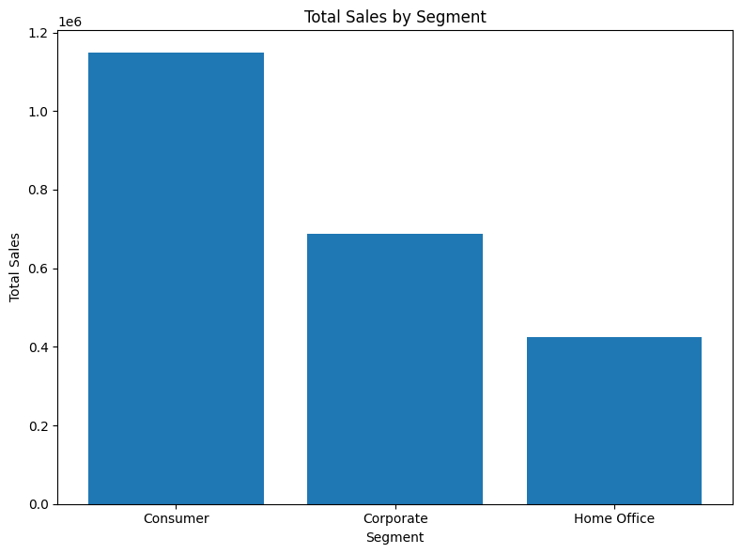
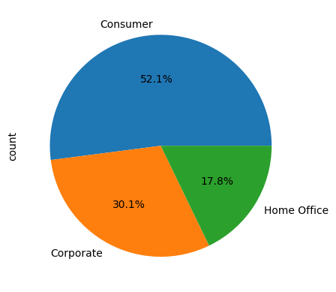
WHAT IS THE MOST IMPORTANT SEGMENT?

Slide 8
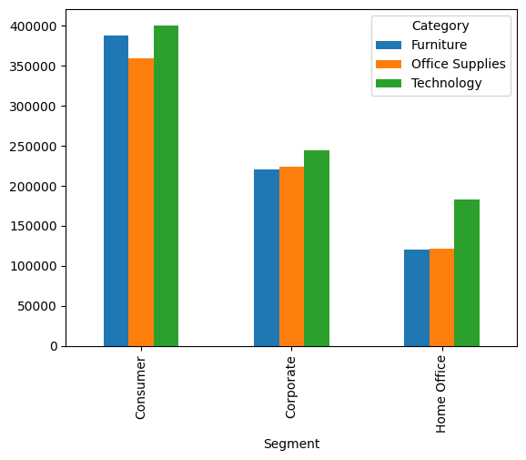
Why did consumer have the highest sales?

Slide 9
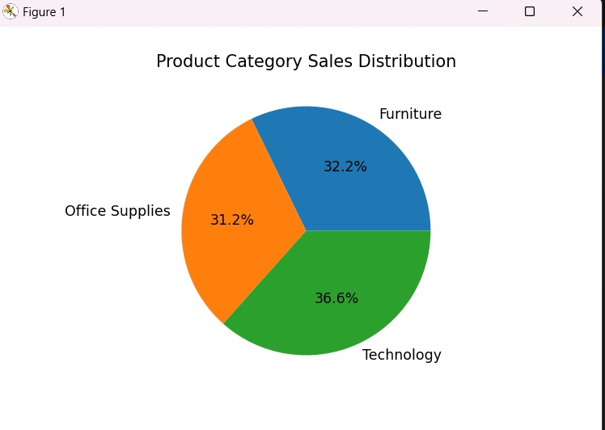
SALES OF CATEGORIES

Slide 10
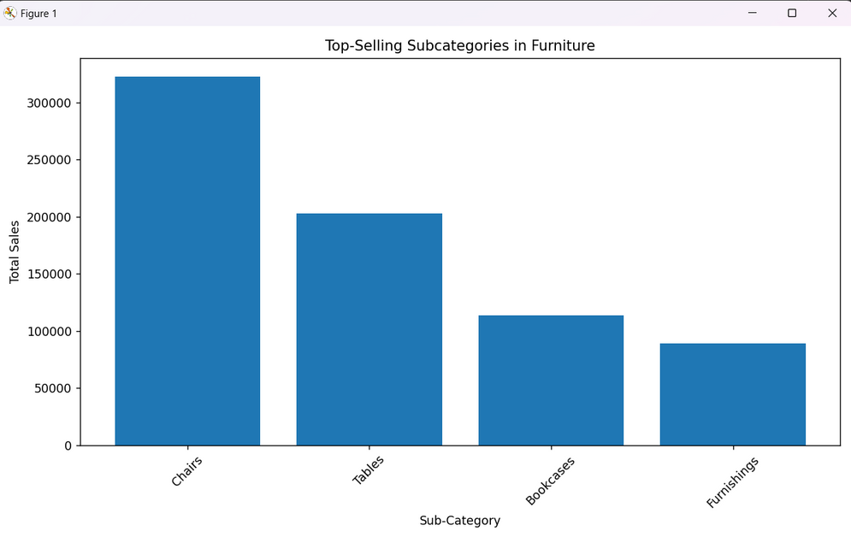
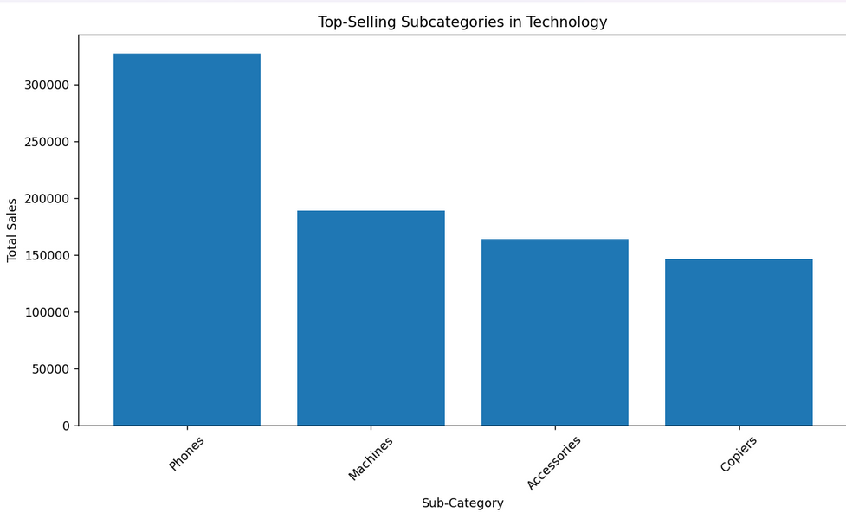
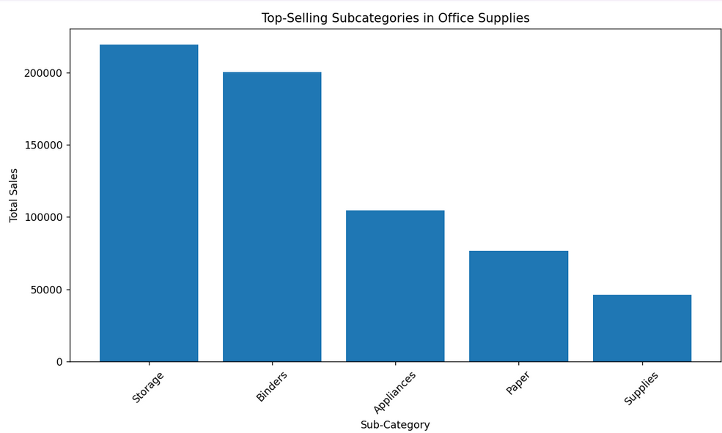
SALES OF HIGHEST SELLING SUB-CATOGRIES

Slide 11
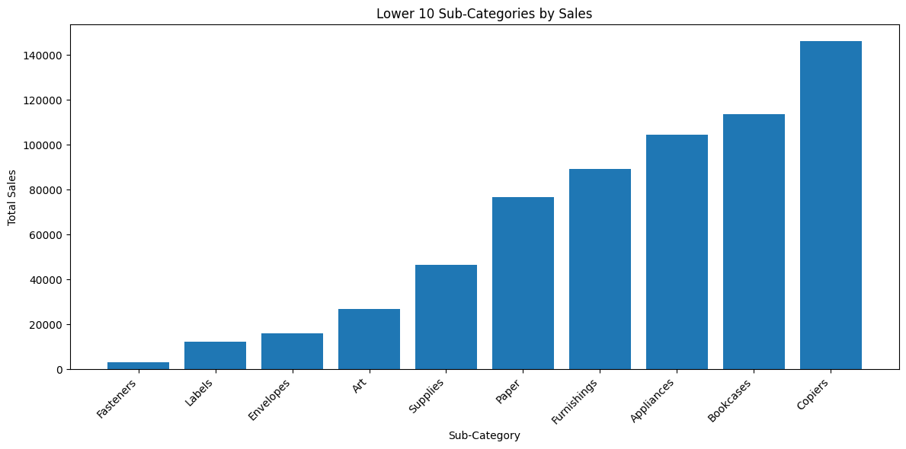
Lowest selling Sub-categories

Slide 12
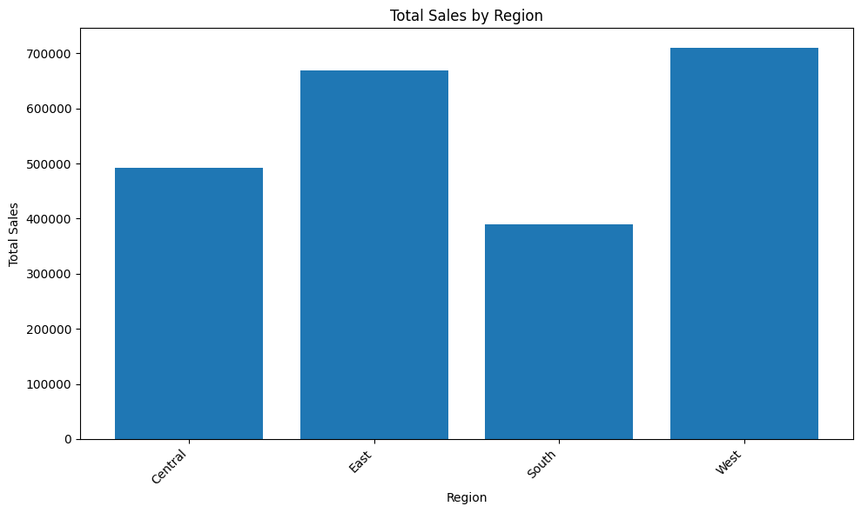
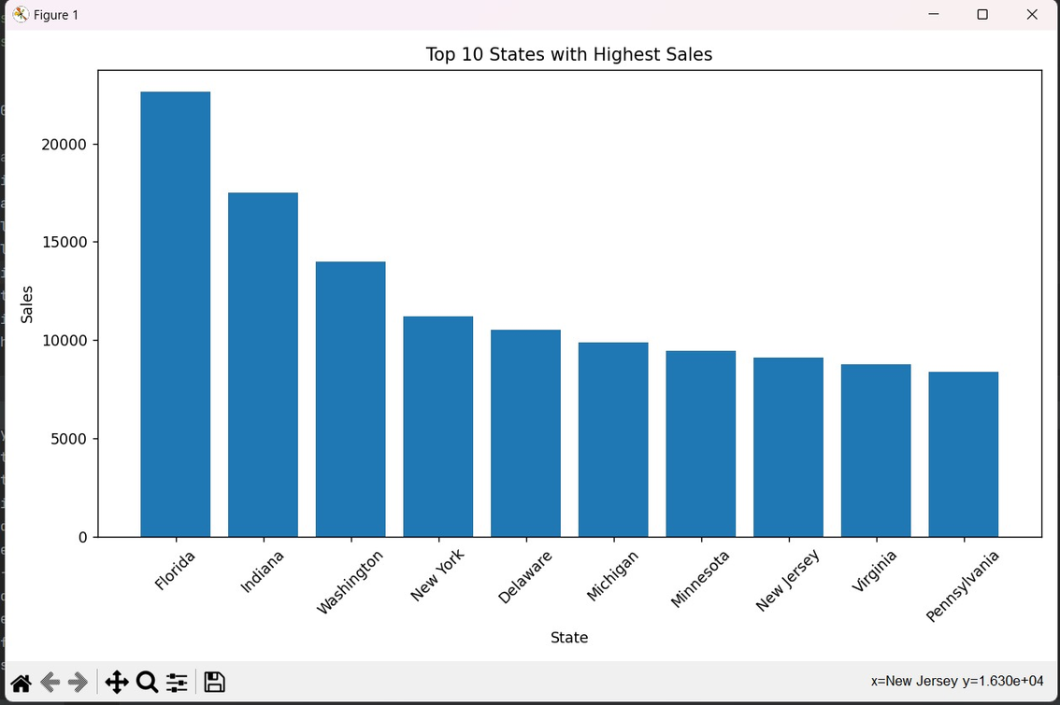
SALES OF REGIONS AND CITIES

Slide 13
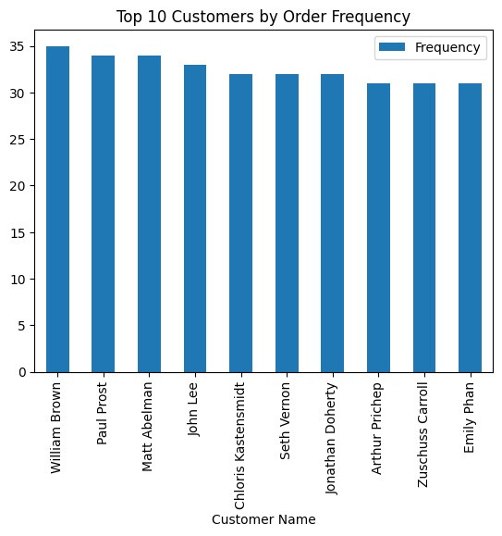
TOP 10 CUSTOMERS

Slide 14
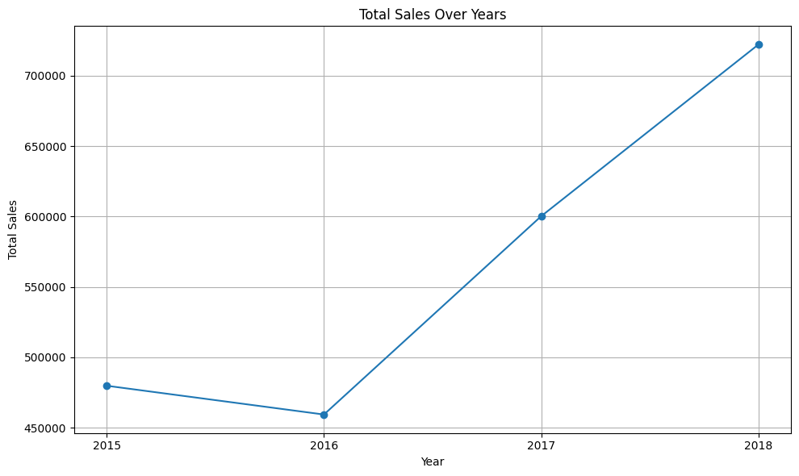
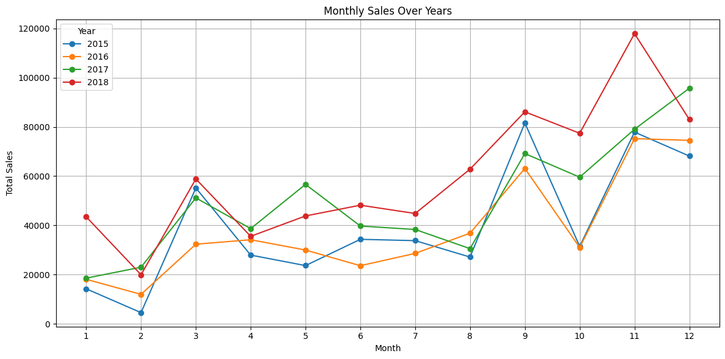
Sales over years

Slide 15
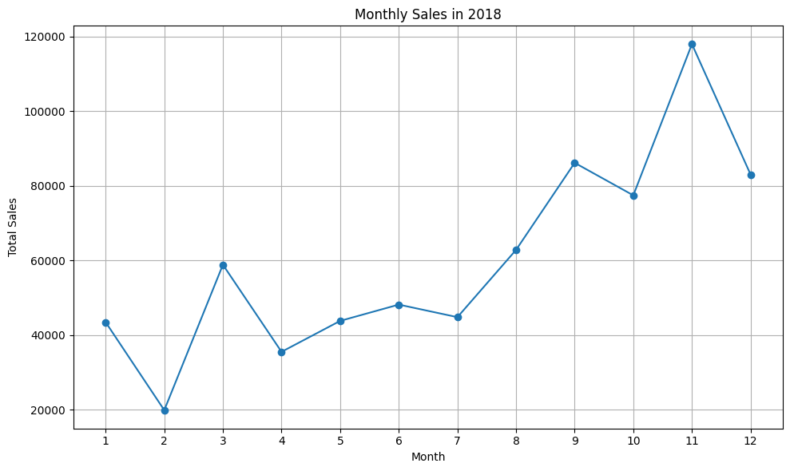
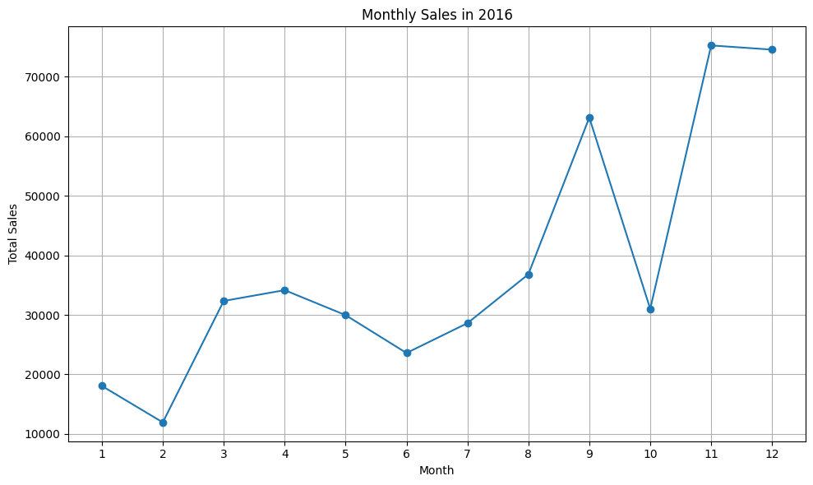
Growth and decline
Why did sales increase during 2018?
Technology
Marketing
Why did sales decrease during 2016?
Global sales had decreased during 2016
Even Apple decreased production.
Political and critical evevts in US

Slide 16
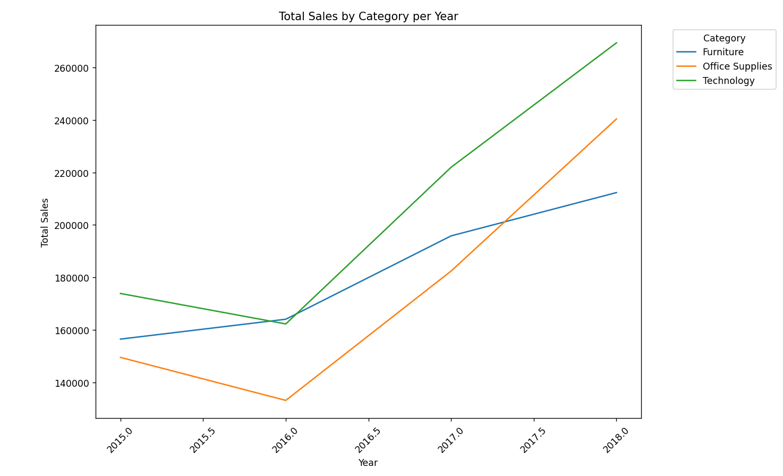
Total sales by category per year

Slide 17
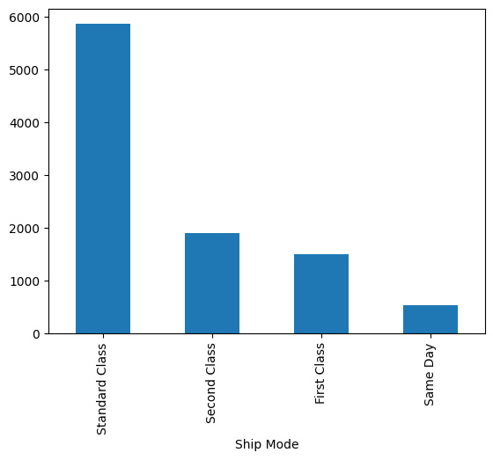
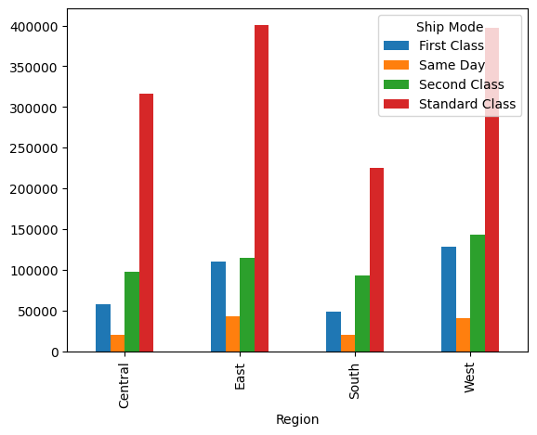
THE MOST PREFFERED SHIPPING MODE

Slide 18
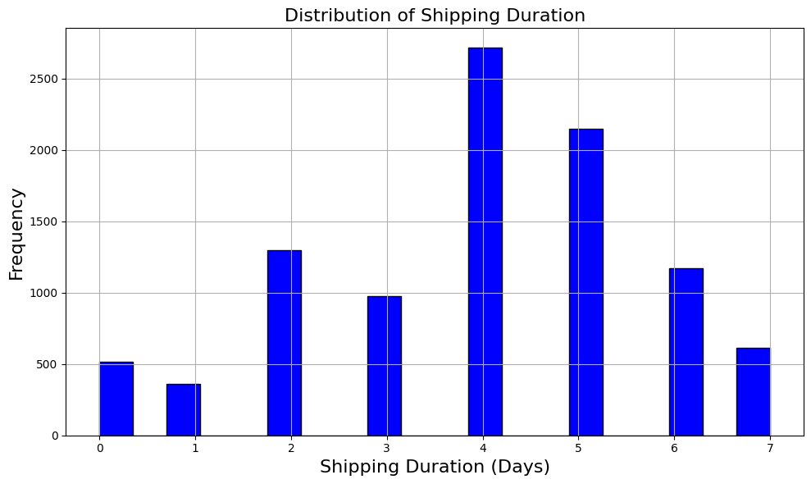
SHIPPING DURATION

Slide 19
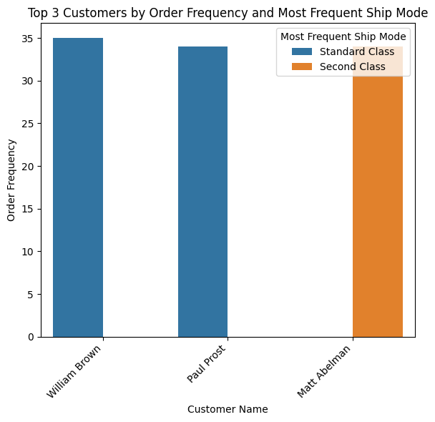
DID SHIP DURATION AFFECT ORDER FREQUENCY?

Slide 20



The Best Selling in the Sub Category is Phones and Chairs with the most Sales (most needed in daily life), both accounting for 29% of the Total Sales. Labels and Fasteners generated the least sales.
Customers frequently choosing Standard Class may indicate satisfaction with the balance of time and cost, even if it involves longer waits.
Cost-effectiveness: Customers might prioritize lower shipping costs, especially for non-urgent technology products.
Product Types: Technology products like phones, accessories, and machines may not require immediate delivery, making Standard Class a more economical and practical choice.
This conclusion aligns with the idea that customers balance shipping costs with acceptable delivery times when choosing shipping options.
Florida represent top state in sales As its Age class range (18:38 Y)
CONCLUSION

Slide 21
Insights on Improvement Opportunities:
Targeted Promotions: For customers who frequently use Standard Class for non-urgent purchases could encourage them to choose quicker shipping options.
Apply discounts and offers for permanent customers
Improved Communication on Delivery Times
Enhance marketing strategy for less selling products
Make a customer survey
After selling service
Ensure the warehouse is close to all regions, open new ones close to others.
Create a survey to assess the customer satisfaction about order time
+
RECOMMENDATIONS
Notes:
Targeted Promotions: For customers who frequently use Standard Class for non-urgent purchases, targeted promotions for faster shipping during specific campaigns (e.g., holidays) could encourage them to choose quicker shipping options.
Improved Communication on Delivery Times: Clear communication about expected delivery times for Standard Class might increase customer satisfaction, especially if the shipping time exceeds expectations in some cases. By setting clear expectations, customers may remain satisfied even with slower delivery.

Slide 22



THANK YOU

